Slide 1

Introduction
Presenters: Dora Wang Fangxin Tang Nay Xie Shulin Zhao Simon Eccleston
Agenda: - The Problem - User Story Prioritisation - The Solution - Deliverables - Retrospective
Solution: Waikirikiri Swim Centre Management System
Objective:
To introduce our innovative web application and showcase its features and benefits.

Slide 2

The Problems
Manually updating user personal information.
Manually scheduling group aqua aerobics classes and swimming lessons.
Manually tracking financial performance.
Manually tracking program performance and attendance.
Rise in number of customer complaints.

Slide 3

User Story Prioritization
High
User Dashboards.
Update user profiles.
Medium
View Aqua Aerobics Schedules and Swimming lessons.
Book Aqua Aerobics Classes and Swimming lessons.
Register new Member
Low
Make payments.
Generate Financial Reports.
Track attendance and popularity of classes.
User Login.
Database design.

Slide 4

The Solution
Data Model
Entity-Relationship Diagram
GUI Design
Colour Scheme
Navigation
User Flow
Overall Interface Layout
Testing

Slide 5
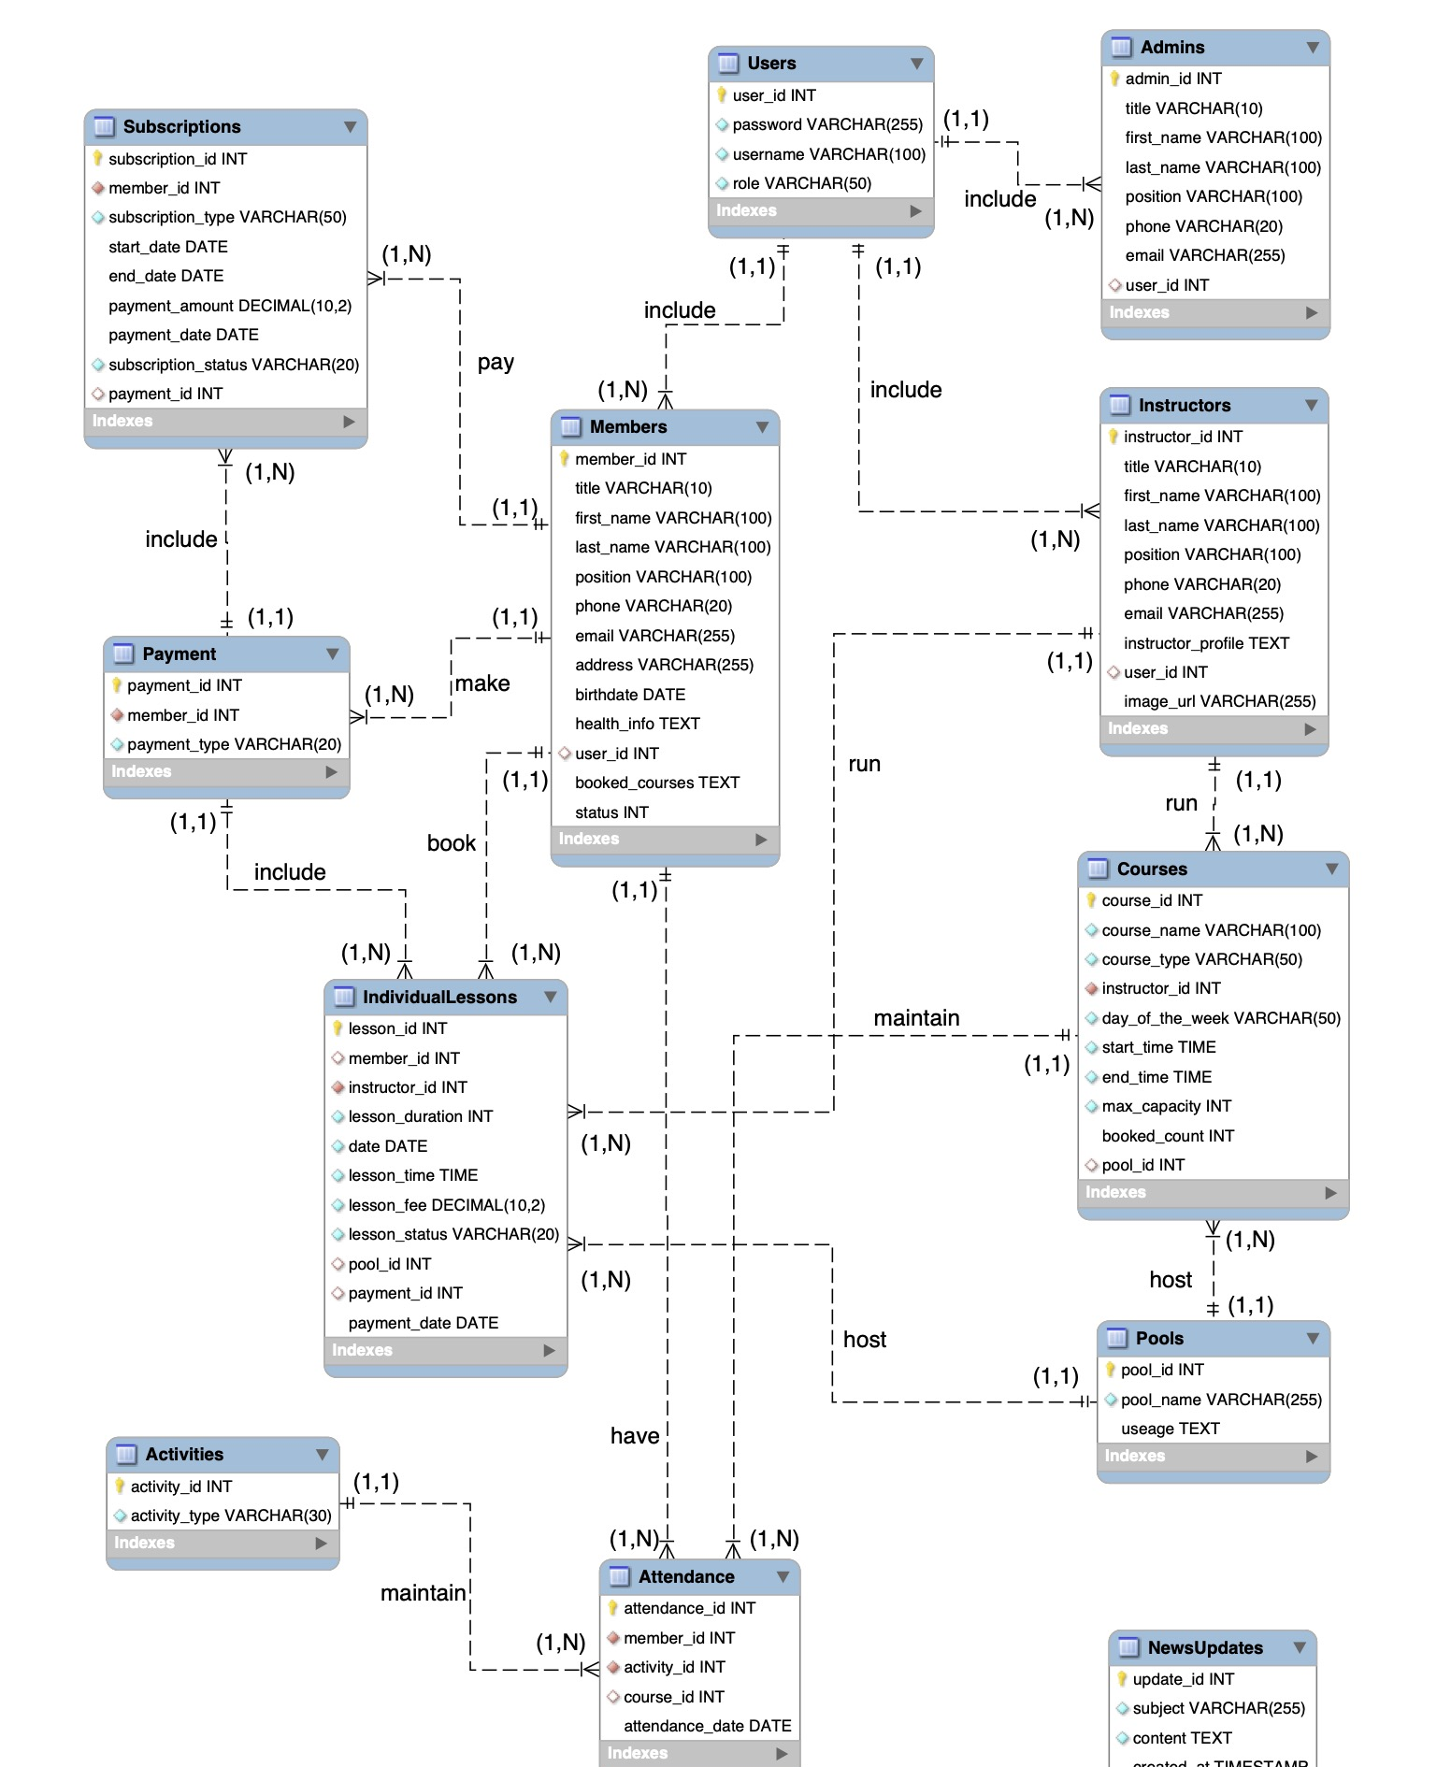
Data Model
Entity-Relationship Diagram
12 entities and either (1,1) or (1,N) relationship
Designed to streamline processes and improve data management.

Slide 6
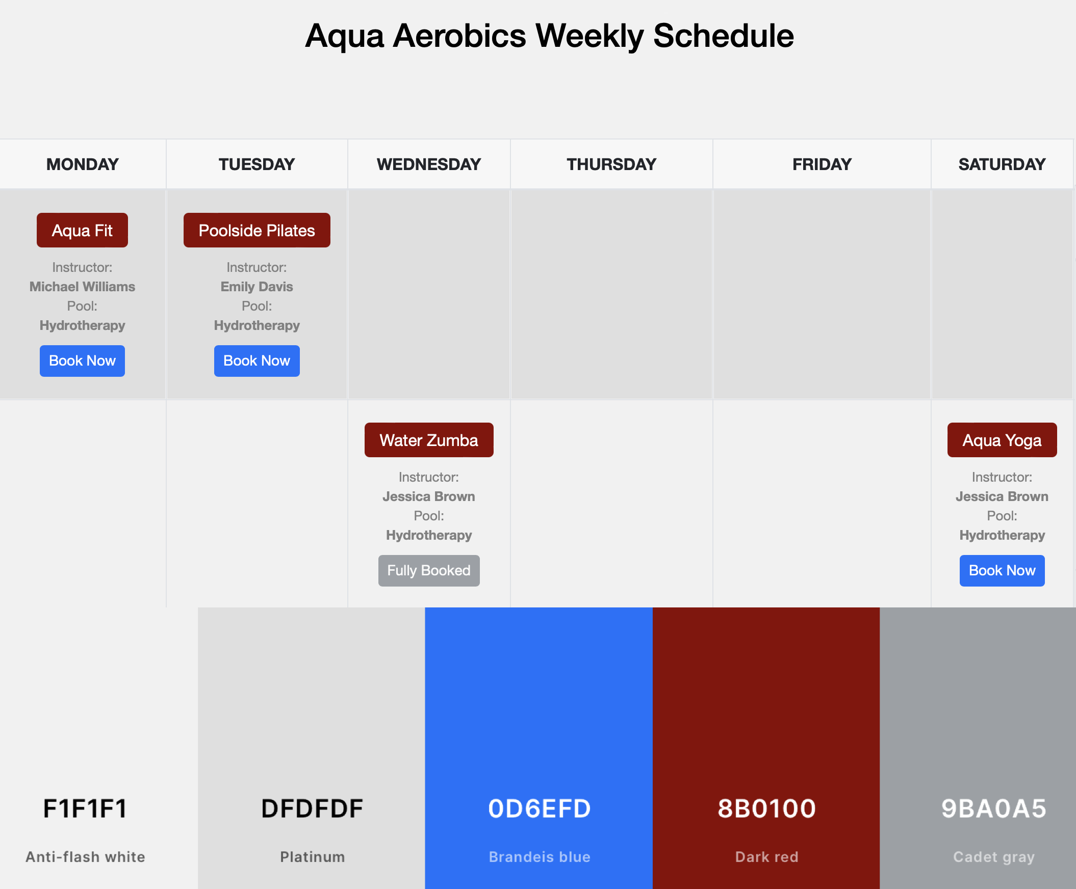
GUI Design
Colour Scheme
Attention to colour contrast, cohesion, text sizes and font weights.
Aligning with the WCAG standards.

Slide 7
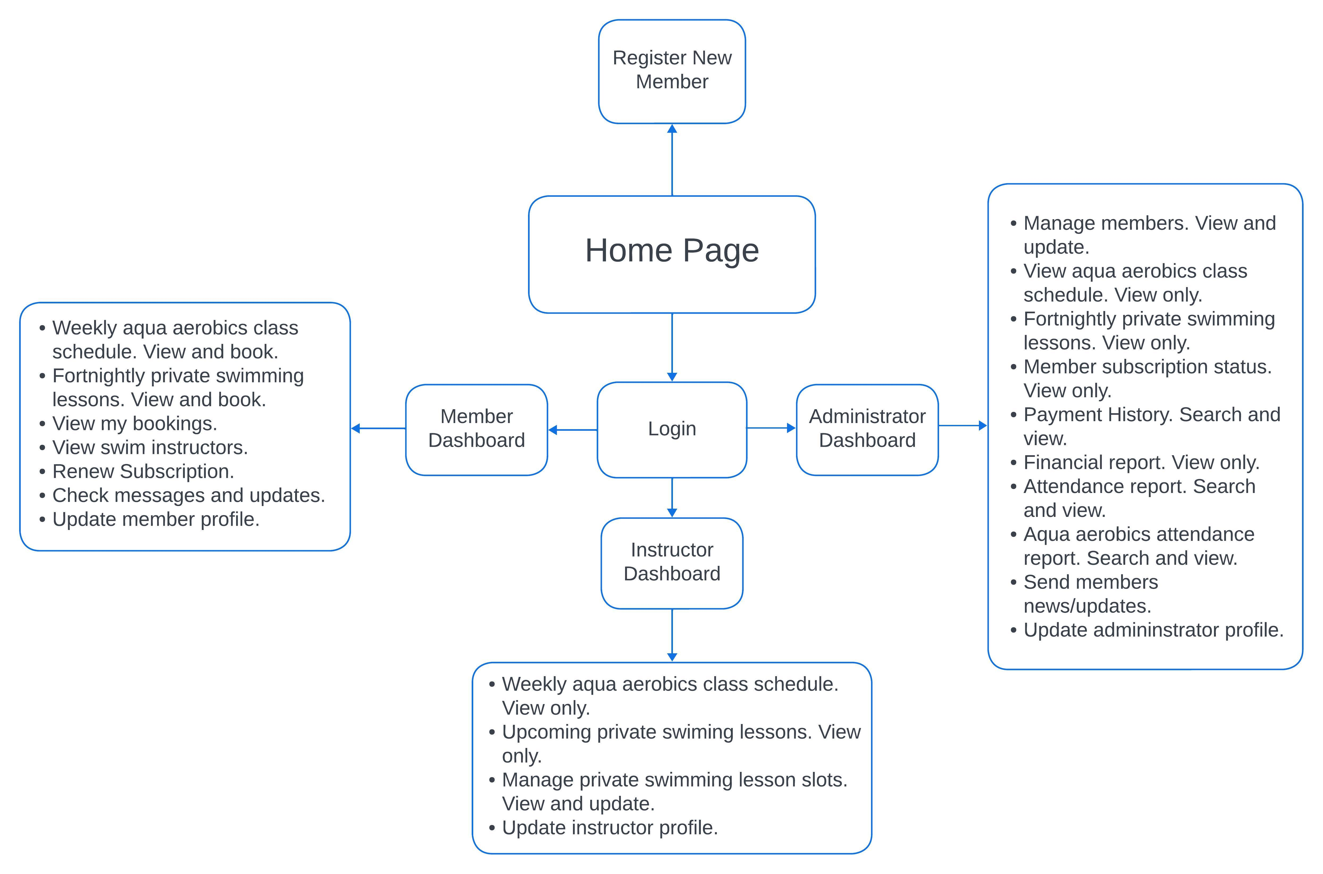
GUI Design
User Flow
A seamless experience for users with distinct roles.
Efficient access to the features they need.

Slide 8
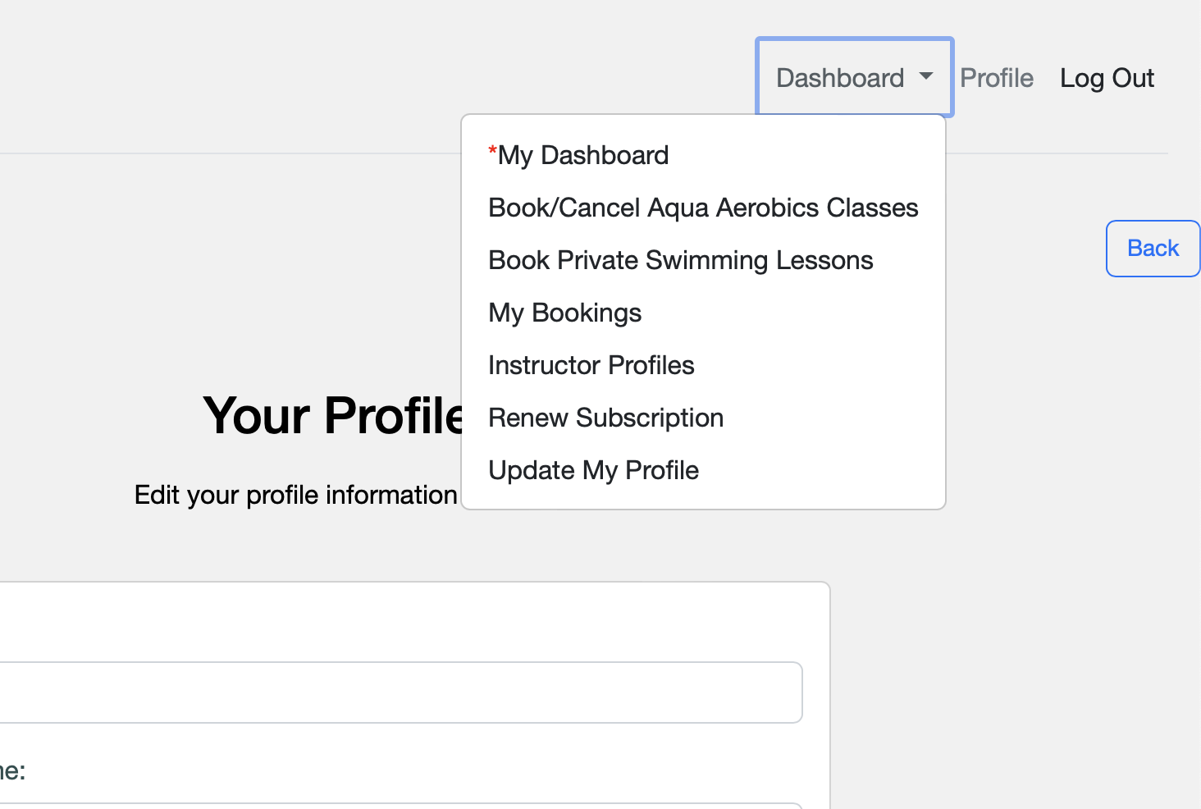
GUI Design
Navigation
Top navigation bar, dropdown menus, back button, and strategically placed buttons and links
Utilising the system's features with ease and efficiency.

Slide 9
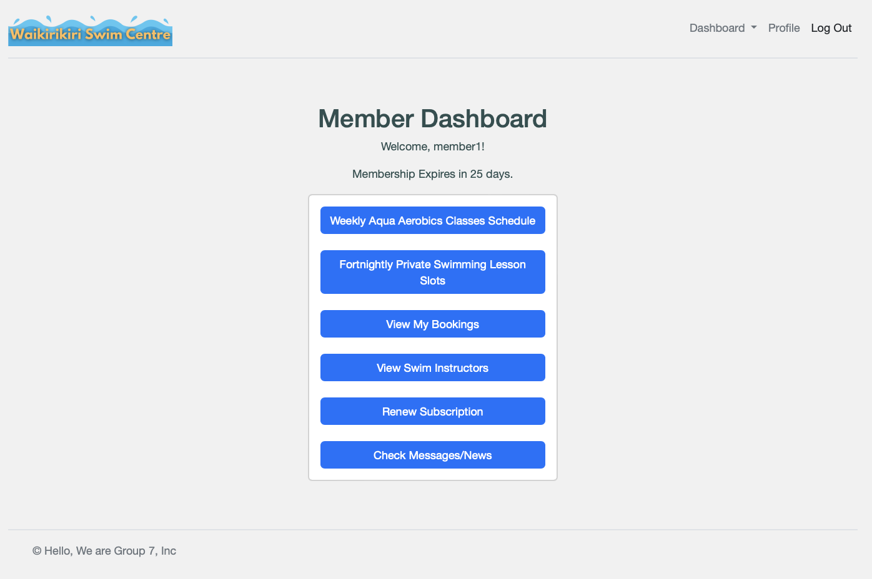
GUI Design
Overall Interface Layout
Header, main content area, and footer
Following a structured and user-friendly design.

Slide 10
Testing
Functional testing for single components, cross-components, and the whole system.
Usability testing for optimal end-user satisfaction.

Slide 11

Deliverables
for All Users
Registration
Login
for Admin/Managers
Add, Delete, Update Members
View Schedules
Payment Tracking
Reports: Attendance, Popularity, Financial
for Members
Communications: Reminders, News/Updates
Booking System: view schedules, book&cancel classes, pay lesson tuition, view booking history
View Instructor profile
for Instructors
View Class Schedules
Subscription Details
Lesson Scheduling
Booking Infomation
Profile Management - Update
Waikirikiri Swim Centre Management System

Slide 12
Users story
All users story completed

Slide 13

Retrospective
What worked well :
Effective Communication
What didn’t :
Github branch at the start of the project
Can do better :
Early App Structuring
Database Development

Slide 14

Thank you!

